Slide 1
IFD’s Industrial Researcher programme
Industrial PhD and Industrial Postdoc

Slide 2
Industrial Researcher programme
Both programmes involve a scientist, a company, and a university/scientific institution.
The scientist works on a research project that is of benefit/interest for all involved parties.
Budget: 150 mio. DKK/year

Slide 3
Purpose of the programme
Develop research talents
Connect industry and research institutions
Contribute to business oriented research

Slide 4
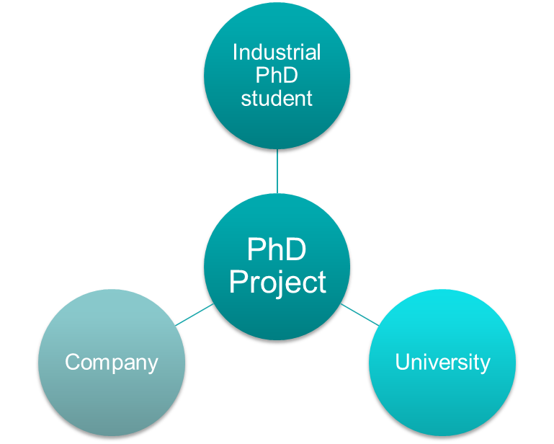
Industrial PhD – basic setup
3-year industrial research project and PhD education
Employment in private/public company in Denmark
Enrollment at a university anywhere in the world
Two main supervisors: at university and company
Notes:
Fokus på Industrial PhD i det her oplæg

Slide 5
Industrial PhD – grade requirements
As an Industrial PhD candidate you need to have
a master’s degree (120 ECTS)
a thesis grade of at least 10
Either a weighted grade average of 9.5 for your master’s degree alone
Or a weighted grade average of 8.2 for your bachelor’s and master’s degrees together
Different rules apply for non-Danish educations. Read our guidelines for Industrial PhD.
Notes:
Snak her om ændringen i forhåndsgodkendelsen.

Slide 6
Industrial PhD – formal requirements
The student has a master degree and meets IFD’s grade requirements
The student works full-time on PhD project/education
The student divides her/his working time between the company and the university, and works on the same project both places
The university is officially authorized to assign PhD degrees
The company can be either private or public
Public companies cannot have permanent research activities within the research area

Slide 7
Industrial PhD – funding
An Industrial PhD student receives at least the same salary as a regular PhD student employed at an university
Company: IFD grants salary subsidy of DKK 17,000/month (max. 50% of expenses) plus DKK 100,000 in travelling subsidies
University: IFD grants subsidy of DKK 360,000 in total (incl. overhead)

Slide 8
Industrial Postdoc – basic setup
1 to 3-year industrial research project
Employment in private/public company in Denmark
Enrollment at a university anywhere in the world
Two main supervisors: at university and company
Notes:
Fokus på Industrial PhD i det her oplæg

Slide 9
Industrial Postdoc – formal requirements
The student has a Phd degree
The postdoc works full-time on the project
The postdoc divides her/his working time between the company and the university, and works on the same project both places
The company can carry the project economically
Notes:
Fortæl om ændring I, at ikke længere er krav om maks 6 mdr. erhvervserfaring.

Slide 10
Industrial Postdoc – funding
An Industrial Postdoc student receives at least the same salary as a regular Postdoc student employed at an university
Company: IFD grants salary subsidy of DKK 22,000/month (max. 50% of expenses) plus DKK 2,500/month in travelling subsidies
University: IFD grants subsidy of DKK 10,000/month (incl. overhead)

Slide 11
Industrial PhD and Postdoc– evaluation procedure
Applications are assessed by the Industrial Researcher Committee
Consists of 21-28 researcher from private and public sector in a broad range of research fields
Evaluation criteria:
The quality of the idea
Impact
Quality in execution

Slide 12
Themes
According to the political agreement on the allocation of the research reserve for 2024 Industrial Researcher projects must lie within the scope of one the following three topics in order to eligible for funding by Innovation Fund Denmark:
Green research, technology and innovation
Life science, health and welfare technology
Digitalisation, technology and innovation
Funds not bound by themes
Greenland & Faroe Islands

